Slide 1
2023-2024
Academic Calendar
Dr. Patty Coté
Teaching & Learning
Regular Board Meeting
February 15, 2023

Slide 2
Considerations:
The Texas Education Agency requires 75,600 instructional minutes for the school year
Spring Break alignment with Austin Community College and University of Texas
UIL Athletic Calendar
Results from the 4-day school week staff and family survey
Recommendations made by the JISD Calendar Committee

Slide 3
Development:
The Calendar Committee met to discuss calendar options for the upcoming school year. The feedback included:
Time for teachers to plan and prepare dispersed throughout the school year
Consideration of a 4-day school week
Staff retention strategies
Student needs
Impact on ALL stakeholders
The Calendar Committee developed calendar drafts based on feedback and requirements of a calendar.
The community and district were able to make their selection of choice for which calendar they preferred.
Office hours with Teaching and Learning were offered to discuss concerns prior to voting.
Calendar Options
Notes:
extended invitation to parents and other district departments.

Slide 4
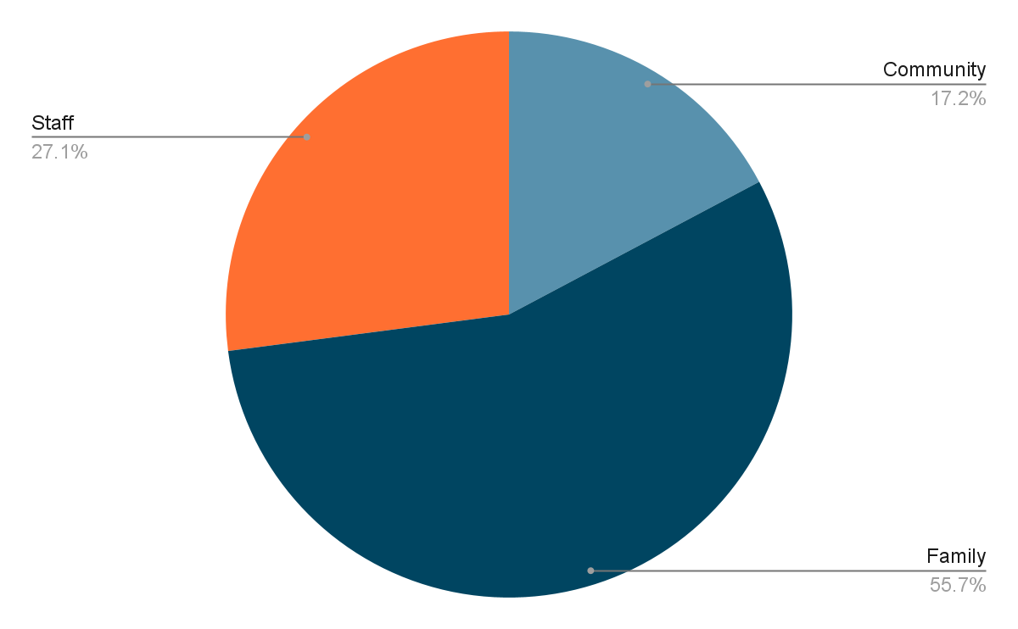
1,323 Responses
Stakeholder | Number of Respondents
Community Member | 228
Family Member | 737
Staff Member | 358

Slide 5
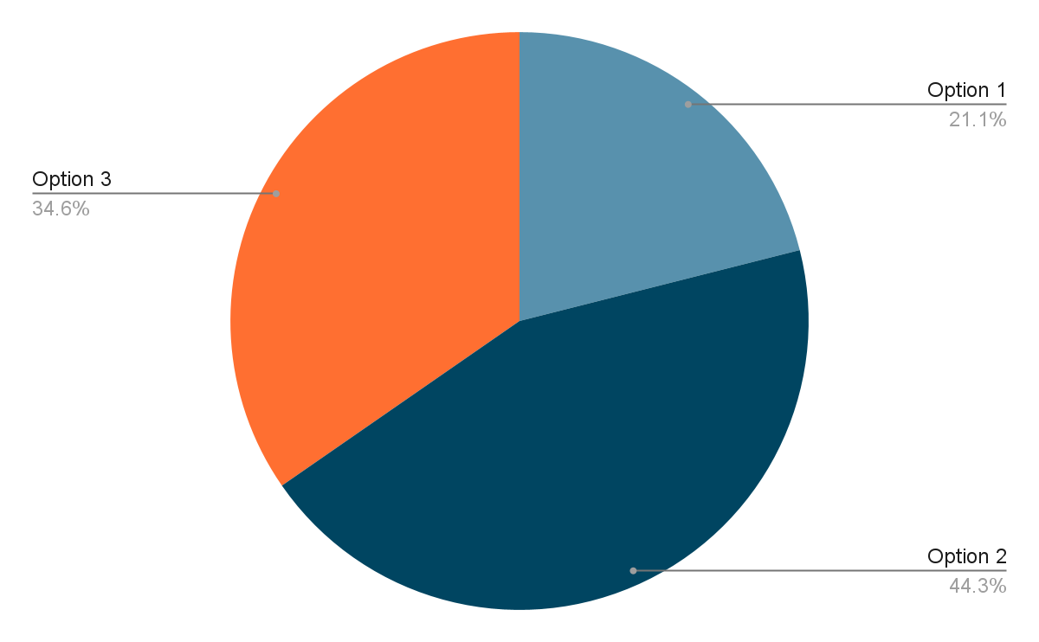
Community Response

Slide 6
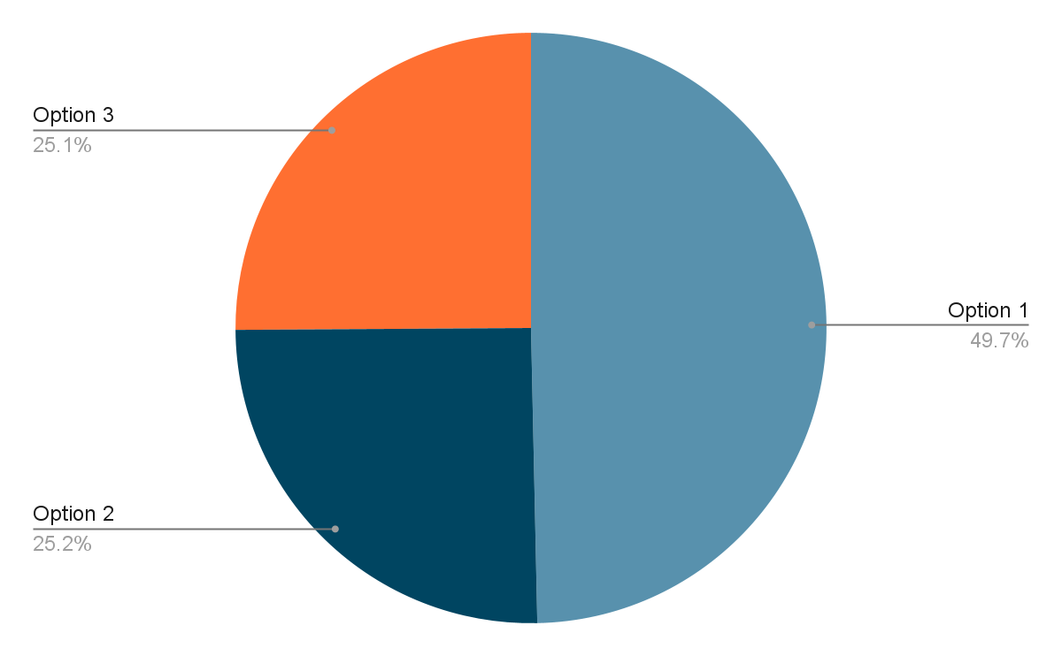
Family Responses

Slide 7
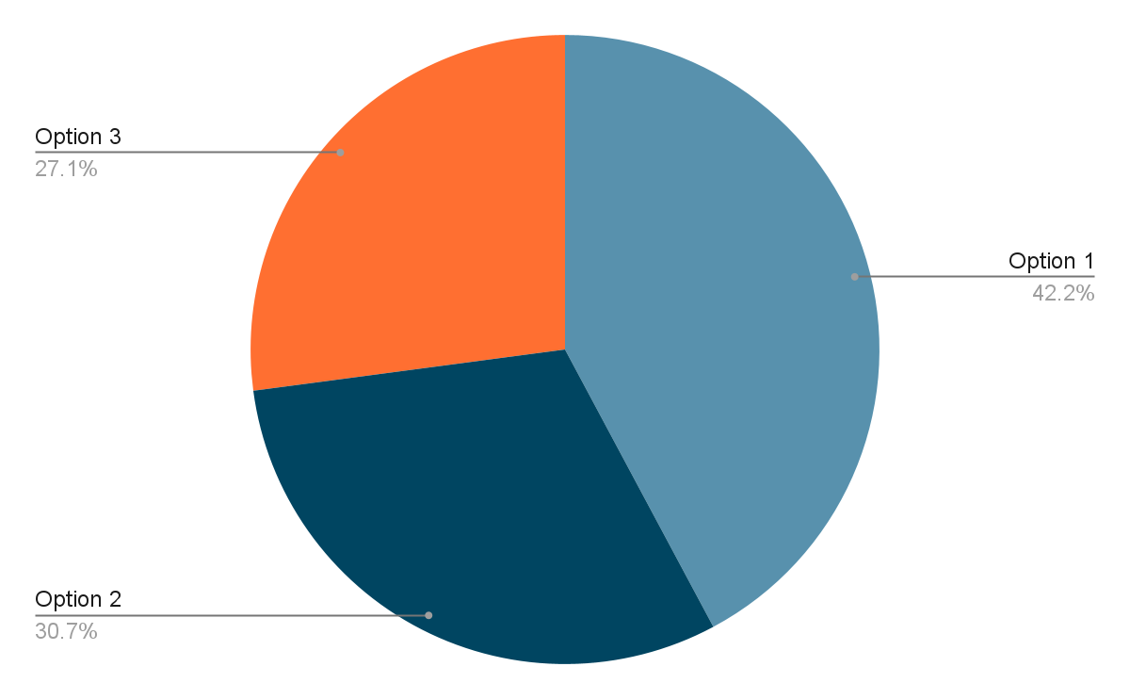
Staff Responses

Slide 8
Approve Option 1, Traditional School Calendar, for the 2023 - 2024 School Year.
Student Start & End Dates: August 16 - May 23
Length of school day for students: 7 hours and 35 minutes
168 School Days for Students
Most instructional days for students
Teacher Start and End Dates: August 3 - May 24
185 Teacher Contract Days (includes 2 exchange days)
17 Days of Professional Learning or Teacher Preparation

